Slide 1
Lecture 5 margin of error, Study and Sampling Designs

Slide 2
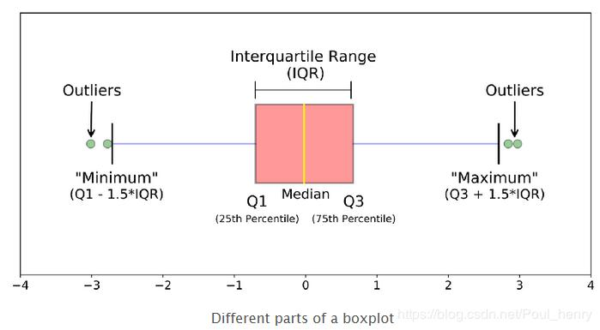
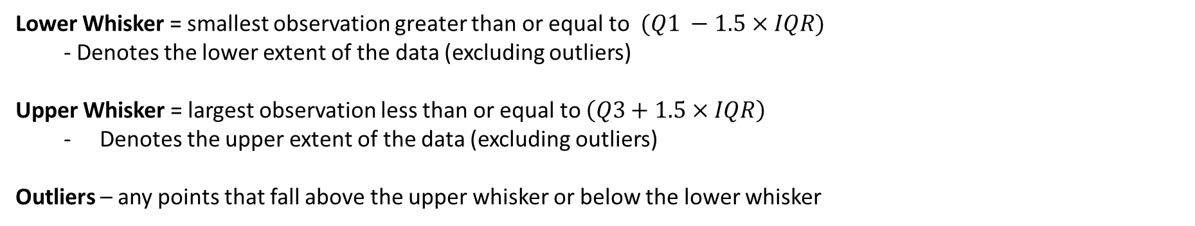
*Correction* to the boxplot construction
Lower Whisker = smallest observation greater than or equal to $(Q1 −1.5×IQR)$
- Denotes the lower extent of the data (excluding outliers)
Upper Whisker = largest observation less than or equal to $\left(Q3+1.5×IQR\right)$
Denotes the upper extent of the data (excluding outliers)
Outliers – any points that fall above the upper whisker or below the lower whisker

Slide 3
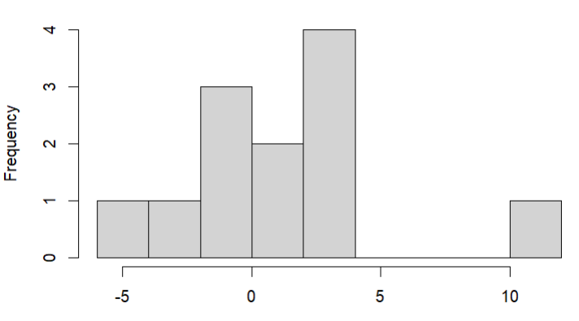
Ex2. Construct a Boxplot
Data = -5.7, -2.6, -1.5, -1.3, -0.4, 0.2, 1.5, 2.2, 2.3, 2.6, 2.9, 10.4
Q1 = -1.4
Q2 = 2.45
Median = 0.85
IQR = 3.85
Lower whisker = -5.7
Upper whisker = 2.9
Upper whisker outlier cutoff = 8.23
Lower whisker cutoff for outliers = -7.18
-10 -8 -6 -4 -2 0 2 4 6 8 10

Slide 4
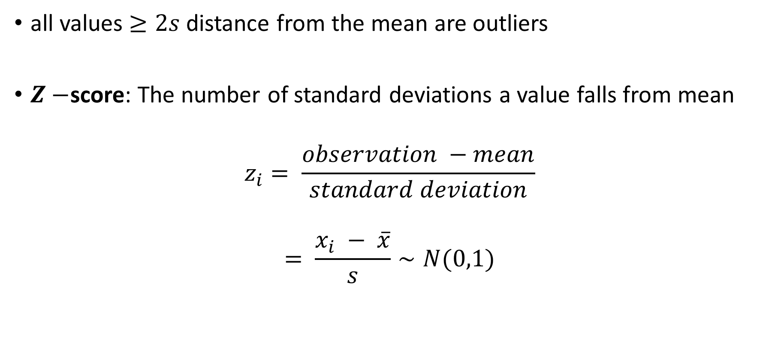
Identifying Outliers: Normal Distributions
all values $≥2s$ distance from the mean are outliers
$Z−$score: The number of standard deviations a value falls from mean
$$z_{i}= \frac{observation −mean}{standard deviation}$$
$$= \frac{x_{i} − \overline{x}}{s}∼N(0,1)$$

Slide 5
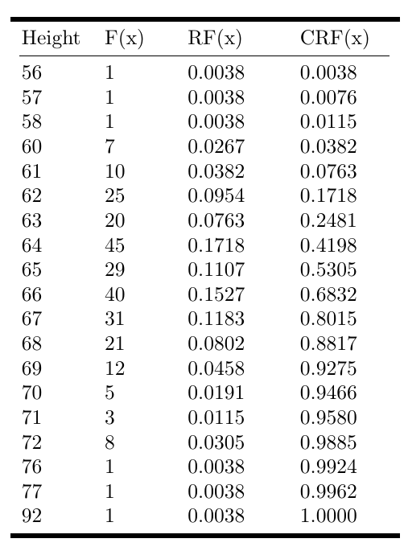
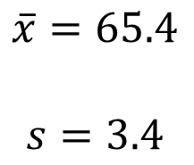
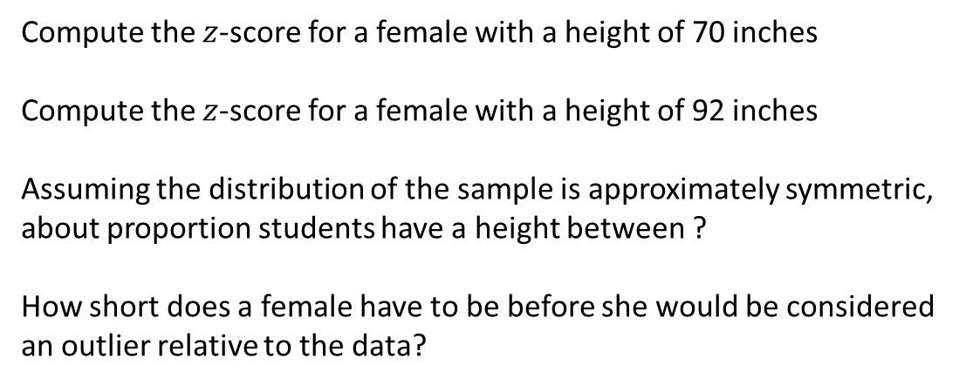
Try it out: Female College Student Heights
Compute the $z$-score for a female with a height of 70 inches
Compute the $z$-score for a female with a height of 92 inches
Assuming the distribution of the sample is approximately symmetric, about proportion students have a height between ?
How short does a female have to be before she would be considered an outlier relative to the data?
$$\overline{x}=65.4$$
$$s=3.4$$

Slide 6
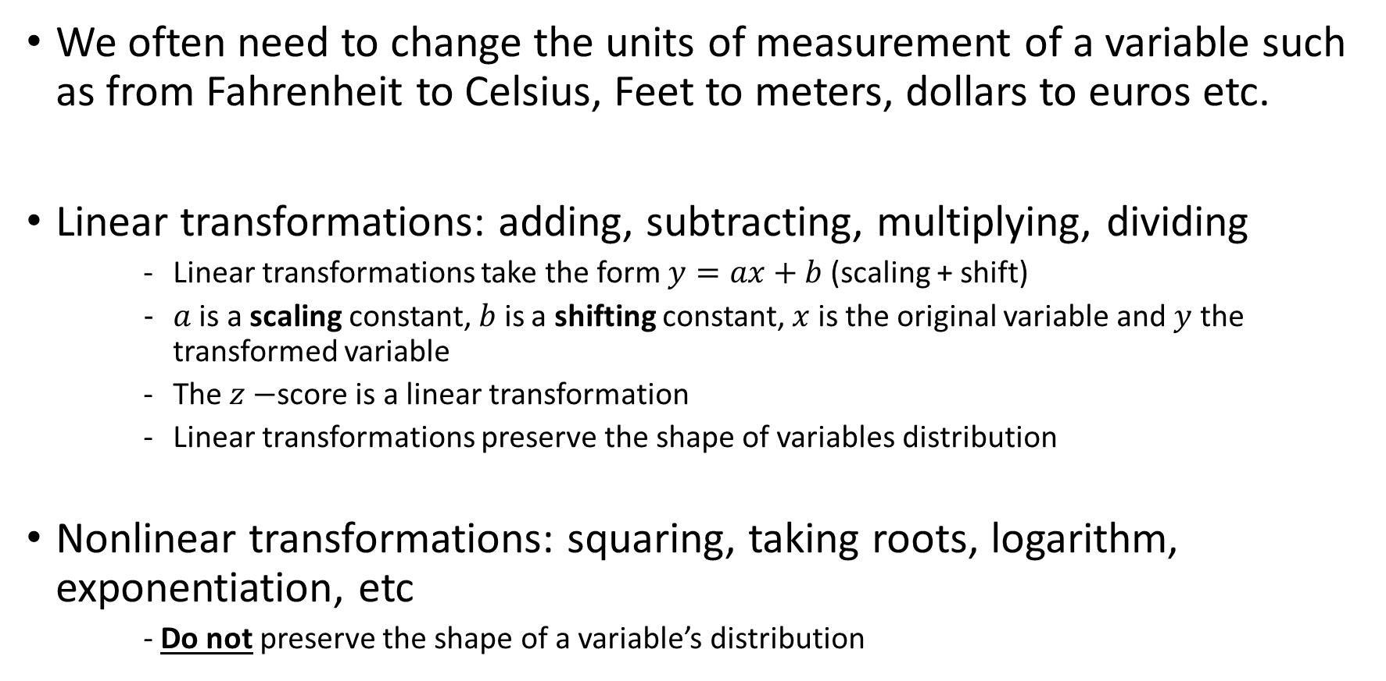
A Note About Transformations of Variables…
We often need to change the units of measurement of a variable such as from Fahrenheit to Celsius, Feet to meters, dollars to euros etc.
Linear transformations: adding, subtracting, multiplying, dividing
Linear transformations take the form $y=ax+b$ (scaling + shift)
$a$ is a scaling constant, $b$ is a shifting constant, $x$ is the original variable and $y$ the transformed variable
The $z−$score is a linear transformation
Linear transformations preserve the shape of variables distribution
Nonlinear transformations: squaring, taking roots, logarithm, exponentiation, etc
- Do not preserve the shape of a variable’s distribution

Slide 7
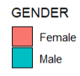
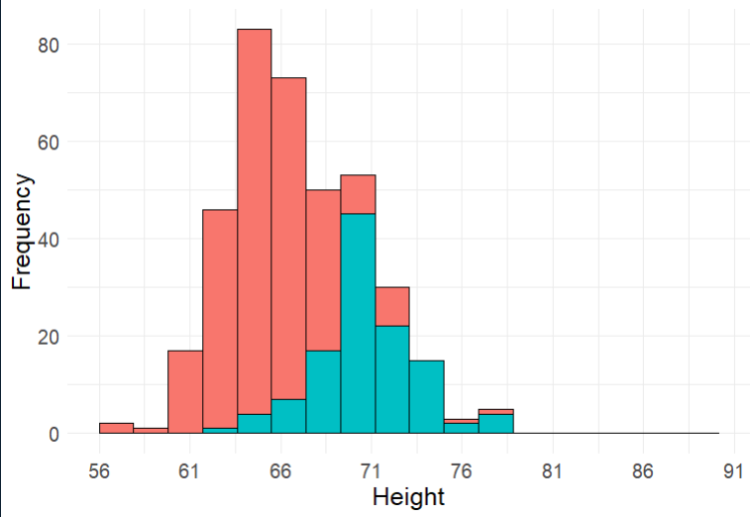
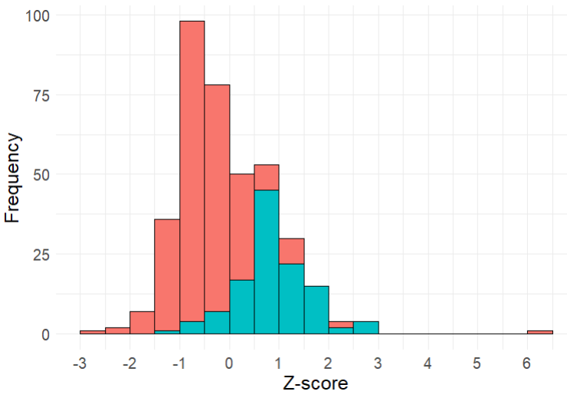
College Student Heights
Original Units
Z-score

Slide 8
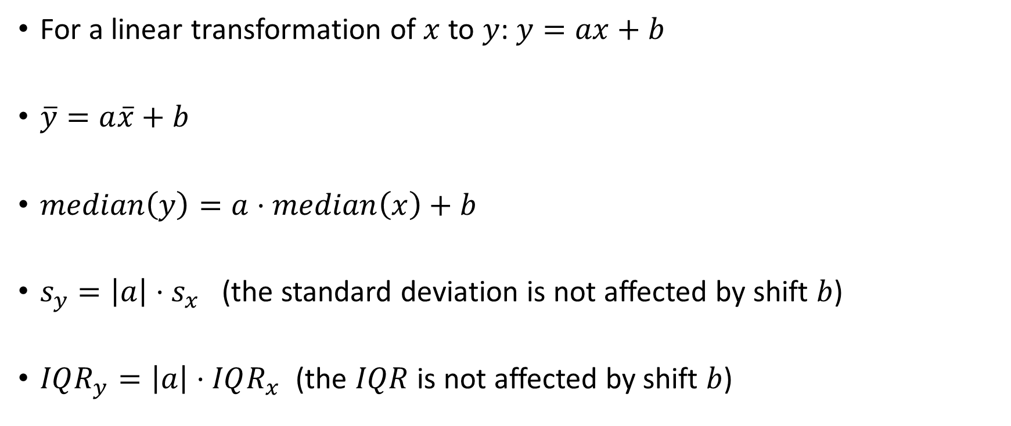
More properties of Linear Transformations
For a linear transformation of $x$ to $y$: $y=ax+b$
$\overline{y}=a\overline{x}+b$
$median\left(y\right)=a⋅median\left(x\right)+b$
$s_{y}=\left|a\right|{⋅s}_{x}$ (the standard deviation is not affected by shift $b$)
$IQR_{y}=\left|a\right|⋅IQR_{x}$ (the $IQR$ is not affected by shift $b$)

Slide 9
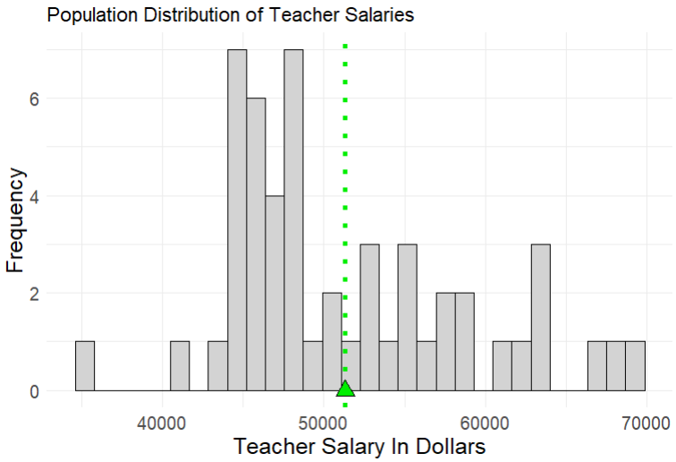
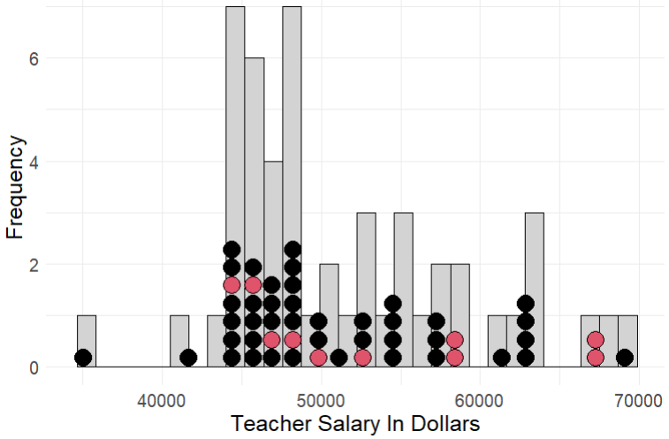
Sampling Distribution
Consider a survey to estimate the mean salary of high school teachers in a given school district. The goal of such a survey would be to use the mean from the sample of observations of teacher salaries (a statistic) as an estimate of the mean salary of the population of teachers in the entire school district (a parameter). This is an example of statistical inference.

Slide 10
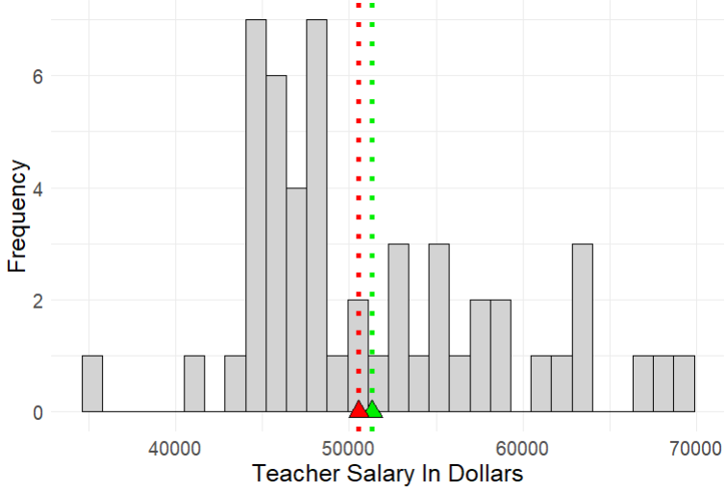
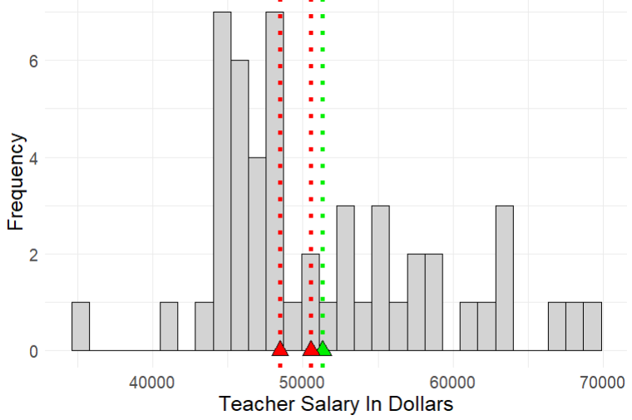
Sampling Distribution
Sample

Slide 11
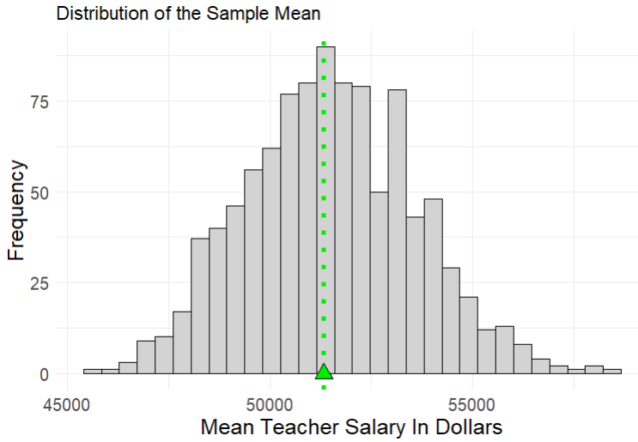
Margin of Error
The margin of error of an estimate measures how far we expect an estimate to fall from the true value of a population parameter
It is a measure of the between sample variability in our estimate
It is the largest distance between the true population parameter and an estimate that is not an outlier
Between sample variability

Slide 12
Sampling and Experimental Designs

Slide 13

Case Study: Cell Phones and Health
Cell phones emit electromagnetic radiation, and a cell phone’s antenna is the main source of this energy. The closer the antenna is to a person’s head, the greater the exposure to radiation. When cell phones started to become popular in the early 2000’s , there was concern over the potential health risks they posed to users. Several studies explored the possibility of such risks

Slide 14
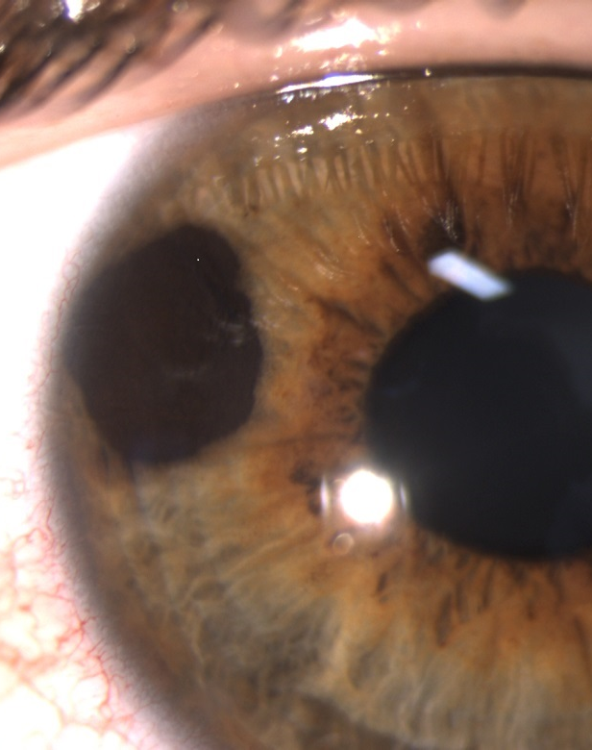
The German Study (Stang et al., 2001)
This study compared 118 patients with a rare form of eye cancer called uveal melanoma to 475 healthy patients who did not have this eye cancer.
Cell phone use was measured using a questionnaire
Findings: on average, the eye cancer patients used cell phones more often

Slide 15
Study 1: The German Study (Stang et al., 2001)
The German population
What is question the authors are trying to answer with data?
Is cell phone use associated with uveal melanoma?
What is the population?
All citizens living in Germany
What is the sample?
Two samples are taken: one taken from the subpopulation of people with uveal melanoma, another taken from the subpopulation of people without uveal melanoma
Uveal melanoma
No uveal melanoma
475 people
118 people

Slide 16

Study 2: The British Study (Hepworth et al., 2006)
This study compared 966 patients with brain cancer to 1,716 healthy patients who did not have brain cancer.
Cell phone use was measured using a questionnaire
Findings: cell phone use for the two groups was similar

Slide 17
The British Study (Hepworth et al., 2006)
The British population
What is question the authors are trying to answer with data?
Is cell phone use associated with brain cancer?
What is the population?
All citizens living in Great Britain
What is the sample?
Two samples are taken: one taken from the subpopulation of people with brain cancer and another taken from the subpopulation of people without brain cancer
Brain Cancer
No brain cancer
1,716 people
966 people

Slide 18
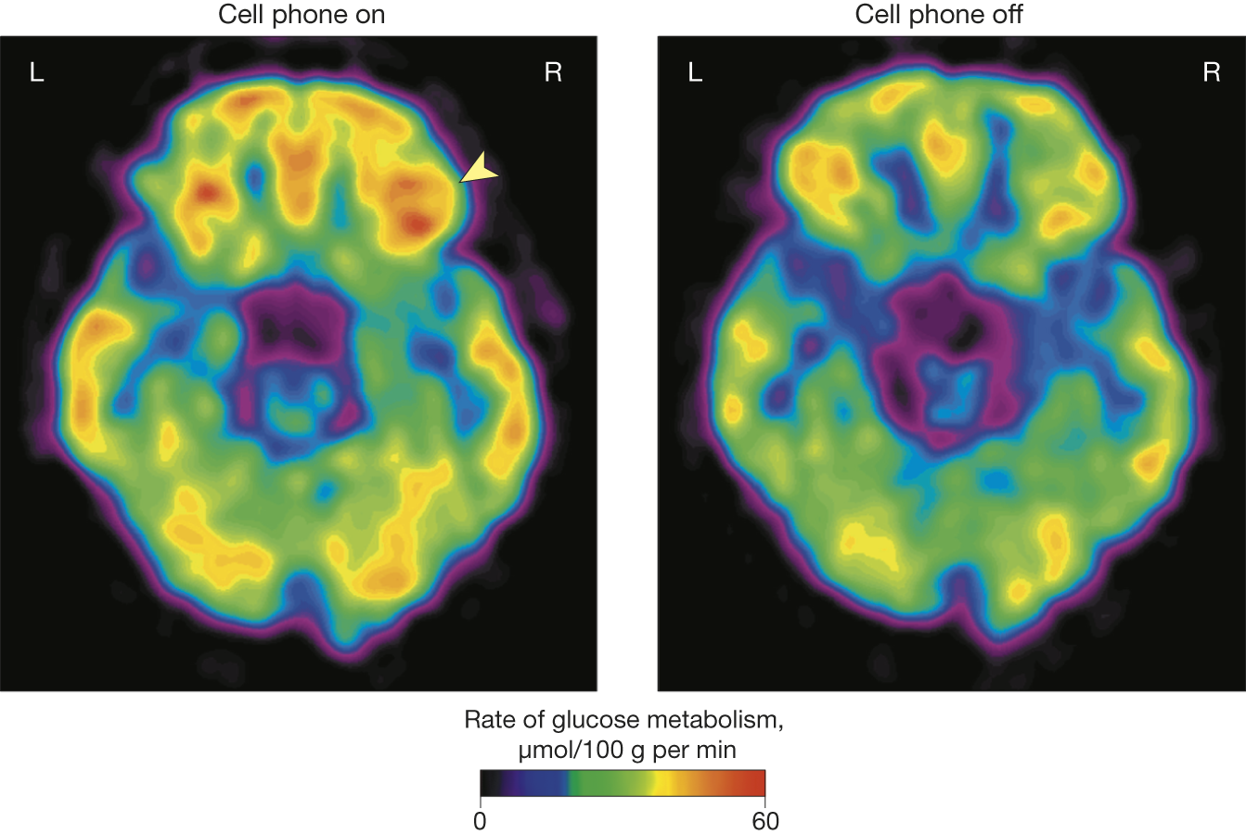
Study 3: (Volkow et al., 2011) – Journal of the American Medical Association
Authors used a randomized crossover study to compare the effects of cell phone use on brain glucose metabolism in 47 individuals.
Patients were fitted with two cell phone devices, one for each ear
- Each patient was given two positron emission topography (PET) scans
- The first was applied when both phones were off
- The second was applied during a 50 minute muted call to one of the two cell phones (the call was randomly assigned to either the right or left phone)
Comparison of the PET scans showed significantly increased activity in the part of the brain closest to the phone.

Slide 19
Study 3 (Volkow et al., 2011) – Journal of the American Medical Association
What is question the authors are trying to answer with data?
Does cell phone use cause increased brain activity (measured as glucose metabolism)?
What is the population?
Any healthy individual
What is the sample?
47 individuals selected as participants

Slide 20
Response and Explanatory Variables
In all 3 studies investigating cell phone use and physiological activity in the brain, the researchers were interested in two variables, a response variable and an explanatory variable
Explanatory variable – this is the variable we manipulate or observe changes in
- what was the explanatory variable in the German study?
Response variable – this variable measures the outcome of interest. Studies focus on how the outcome “responds” to changes in the explanatory variable
- what was the response variable in the German study?
A study can have multiple response variables and multiple explanatory variables

Slide 21
What is “good” data?
Studies 1 and 3 conflict with the results of study 2 – which should we trust?
Study and sampling designs can have a major impact on results…
Knowledge of different study designs helps guide us in deciding what research we should trust and when we should be skeptical.

Slide 22
Experimental vs Observational Studies
In an experimental study, researchers assign subjects to experimental conditions called treatments and then observe outcomes of the response variable(s).
In an observational study the researcher observes values of the response and explanatory variables in different subjects without any manipulation of the subjects in the study
Which (if any) of the three studies we examined are experimental? Which are observational?

Slide 23
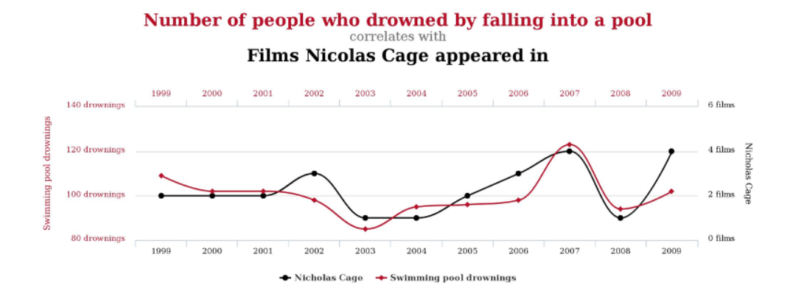
Association vs Causation
A statistical association between two variables is a numerical measure of their relatedness.
A causal relationship between two variables means that changing one variable causes a proportional change in the other variable (also called a cause and effect relationship)
An association between two variables does not imply causal relationship between them
Example: there is a statistical association between the number of people who drowned by falling into a pool and the number of films Nicolas Cage appeared in a given year. However, there is obviously no causal relationship.

Slide 24




Advantages of Experimental Studies
Study Design
Observational studies cannot definitively establish causation
Observational studies are prone to lurking variables – a variable unknown to the researchers that is not included in the study and has an association with both the response and explanatory variables
Lurking variables can induce false associations between response and explanatory variables.
In experimental studies subjects (observations) are randomly assigned to treatment groups.
this randomization balances the effect of lurking variables between the treatment groups and removes their influence on the association between the response and explanatory variables
Observational Study
Experimental Study
Population
Population
Sample
Sample
Treatment
Control

